Slide 1

FORECASTING THE ELECTRICITY DEMAND USING MACHINE LEARNING ALGORITHMS.
SHAILESH GOGINENI
CHANDU SOMEPALLI

Slide 2
INTRODUCTION
•Forecasting the electricity demand has been the key task to reach the long-term goals of European Union. Inadequacy of accurate measurement of electricity demand which further causes the under generation or over generation of electricity and may also results in huge investments on energy resources.
•The aim is to short-term forecast the electricity demand using the seasonal auto-regressive Integrated moving average (SARIMA).
•In this study we use publicly accessible data based on machine learning algorithms to develop forecasting models for electricity demands. It measures accuracy using various measurement criteria widely used in analysis and regression of the time series.
•The predictors are partitioned into training (80%) and testing (20%) subsets to construct the forecasting models. these models are assessed using statistical metrics.

Slide 3
RESEARCH QUESTION
•How the machine learning algorithms help the factors affecting consumption of electricity?
• Which month/season of the year consumes more electricity?
• For the short-term prediction, which machine learning algorithm gives better accuracy?

Slide 4
LITERATURE SURVEY-1
Author: Ringwood et al.,
TITLE: Forecasting electricity demand on short, medium and longtime scales using neural networks
AIM&OBJECTIVES: To forecast the demand of electricity weekly, monthly and yearly in Ireland using neural networks
SAMPLE: The generous data produced by electricity supply board (ESB) in republic of Ireland
DATA ANALYSIS METHOD: LervenbergMarquardt algorithm and Monte-Carlo algorithms are used in training for fastest computation
FINDINGS RELEVANT TO REVIEW: They concluded that Artificial Neural Networks (ANN) outperforms than other network models in deep learning

Slide 5
LITERATURE SURVEY-2
Author: p chen et al.,
TITLE: Time series forecasting of temperature using SARIMA: An Example from Nanjing
AIM&OBJECTIVES: To predict the demand of electricity a month ahead in the Nanjing city, China using SARIMA
SAMPLE: The data from 1951 to 2014 has used for training the model and the data from 2015 to 2017 used for testing using SARIMA techniques
DATA ANALYSIS METHOD: They first calculated the ARIMA with the Box-Jenkins method and then added the seasonal components to ARIMA
FINDINGS RELEVANT TO REVIEW: They avoided the over and under fitting with a very low MSE of 0.89 percent and forecasted next 36 months based on past 35 years of data

Slide 6
DATA COLLECTION
• The dataset considered for this research is smart meters in London from the Kaggle. This huge dataset from Kaggle is of 1 gigabyte in zip folder which further includes 9 files such as daily dataset, half hourly dataset, weather daily and hourly dataset, information household and UK bank holidays dataset.
• Out of these 9 files, we considered three .csv files for our further research i.e., Block-wise half hourly consumption data, daily weather data and UK bank holidays data. The half-hourly data of one block out of 111 blocks is used for training the model from the block-wise half hourly data which consists of 25287 rows of 50 different households from 20 November 2011 to April 2014.

Slide 7
DATA PREPROCESSING
• During the data understanding and data collecting stage, the source of the data, size of the data and features of the dataset have determined. In the preparation of data, we will learn about normalizing the data, univariate time series data and data cleaning. The open source Kaggle data is used to prepare the data or clean the data to forecast electricity demand. Relevance of the data, quality of the data and many technical constraints are taken into consideration while selecting the dataset.
For the selected data, the cleaning process has following steps:
1. Removing null values from the data
2. Creating new columns for better understanding the data
3. Normalizing the data

Slide 8
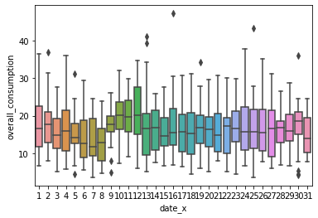
• The weather data is chosen to include the seasonality to the electricity dataset which results with better accuracy. From the list of columns, we have selected the variables which have numerical values and dropped down the remaining. The date is included to the dataset to calculate the results daily based on date and the daily consumption of electricity with respect to weather data is shown below:
Boxplot of daily electricity consumption with respect to weather:

Slide 9
TIME SERIES ANALYSIS
• A time series is any sequence of observations reported at specified times and usually presented as a plot of the time series. This is a graph in which the observations are mapped as time function. The set of times T at which recorded electricity consumption values may be a discrete set.
• The main objective of the time series analysis is to predict the series of future values by extracting a hidden signal and discovering 25 the process by which the data is generated, simulating the series independent realizations to see how it will behave in the future.
• Time series forecasting is mainly divided into two types. One is univariate analysis which analyses single variable over time and the other is multivariate analysis which examines two or more variables over time. The time series forecasting is used to predict the future values based on past values

Slide 10

SARIMA for Time Series Forecasting
We can study this theory dividing into 4 parts:
What Is SARIMA?
What’s Wrong with ARIMA
How to Configure SARIMA
How to use SARIMA in Python

Slide 11
What’s Wrong with ARIMA
• Autoregressive Integrated Moving Average, or ARIMA, is a forecasting method for univariate time series data.
• As its name suggests, it supports both an autoregressive and moving average elements. The integrated element refers to differencing allowing the method to support time series data with a trend.
• A problem with ARIMA is that it does not support seasonal data. That is a time series with a repeating cycle.
• ARIMA expects data that is either not seasonal or has the seasonal component removed, e.g. seasonally adjusted via methods such as seasonal differencing.

Slide 12
What is SARIMA?
• SARIMA is Seasonal ARIMA, or simply put, ARIMA with a seasonal component. As mentioned above, ARIMA is a statistical analysis model that uses time-series data to either better understand the data set or to predict future trends. It consists of 3 components –
Component | Explanation
Autoregressive | A model that uses the dependent relationship between an observation and some number of lagged observations.
Integrated | The use of differencing of raw observations (e.g. subtracting an observation from observation at the previous time step) in order to make the time series stationary.
Moving Average | A model that uses the dependency between an observation and a residual error from a moving average model applied to lagged observations.

Slide 13
HOW TO CONFIGURE SARIMA
A typical SARIMA model equation looks like the following –
SARIMA(p,d,q)x(P,D,Q)_{lag}
The parameters for these types of models are as follows:
p and seasonal P: indicate the number of AR terms (lags of the stationary series)
d and seasonal D: indicate differencing that must be done to stationary series
q and seasonal Q: indicate the number of MA terms (lags of the forecast errors)
lag: indicates the seasonal length in the data

Slide 14
HOW TO USE SARIMA
To use SARIMA there are three steps, they are:
Define the model.
Fit the defined model.
Make a prediction with the fit model.

Slide 15
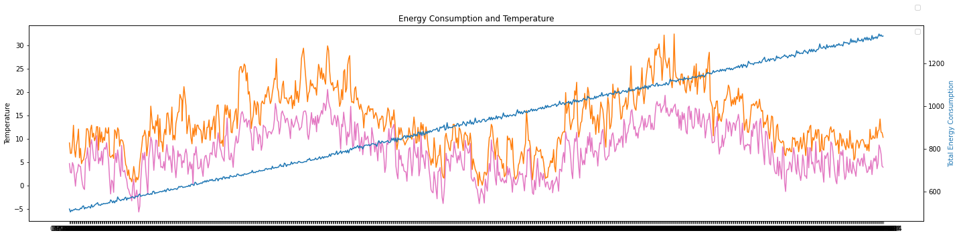
IMPLEMENTATION
The weather data gave the relationship between the electricity consumption and various factors effecting it such as temperature and UV index is inversely related to the electricity consumption; humidity, visibility follows the same trend as 29 electricity consumption.

Slide 16
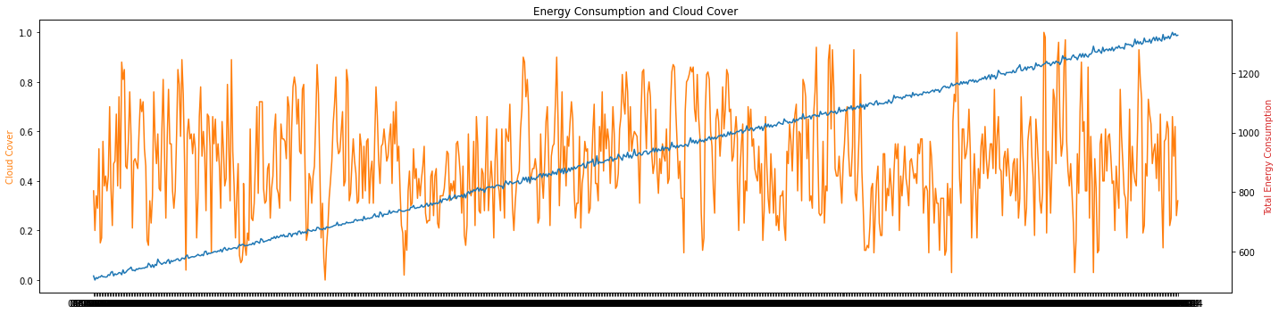
Graphical representation of electricity consumption and Cloud cover

Slide 17
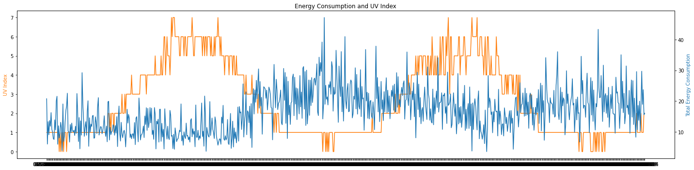
Graphical representation of electricity consumption and UV index

Slide 18
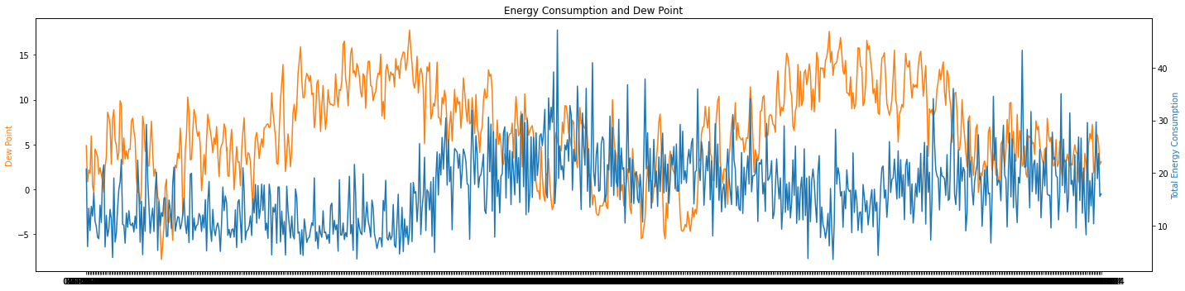
Graphical representation of electricity consumption and UV index

Slide 19
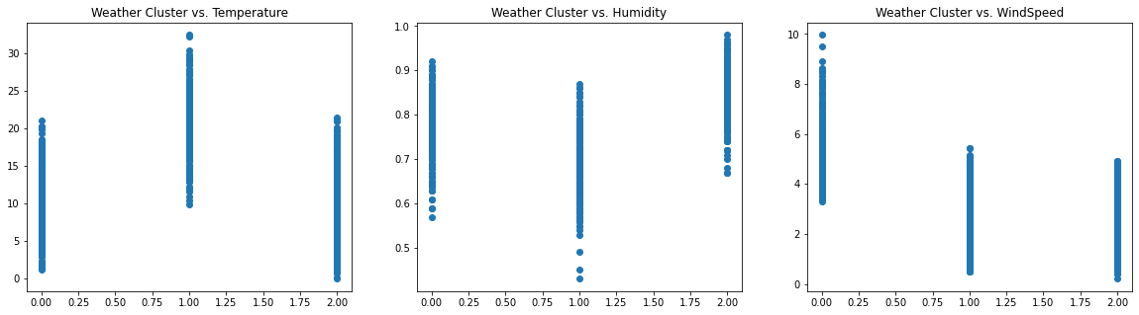
CLUSTER RELATIONSHIP WITH WEATHER VARIABLES

Slide 20
K-MEANS CLUSTERING
After finding the correlation between all the variables, the next step is to perform k-means algorithm on the dataset to the unlabelled weather scaled data which is obtained after removing less correlated variables.
The steps to apply the algorithm are: • The K=3 centroids are initially given at random • The clusters are formed based on the nearest data points to the centroid • The mean in the clusters is used to update the centroid position • The above steps are repeated until the centroids become stable

Slide 21
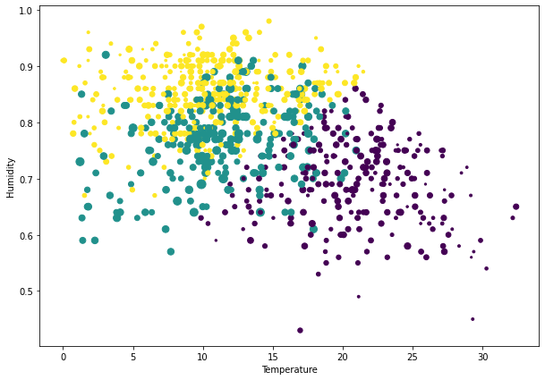
Clusters formed by k-means algorithm

Slide 22
SARIMA Modeling
This framework helps to understand the model building process in a structured manner. It involves the following steps –
Plot the series – to check for outliers
Transform the data (to make mean and variance constant)
Apply statistical tests to check if the series is stationary (Both trend and seasonality)
If non-stationary (has either trend or seasonality), make it stationary by differencing
Plot ACF of stationary series for MA order, Seasonal MA order at seasonal spikes
Plot PACF of stationary series for AR order, Seasonal AR order at seasonal spikes
Run SARIMA with those parameters
Check for model validity using residual plots

Slide 23
The auto correlation plot displays a gradual decay and the partial auto correlation plot shows the sharp drop after the first lag. Based on the graphs it is implied that most of the higher-order autocorrelations are effectively explained by the k=1 lag. Hence, the series displays ‘AR’ signature.
Dickey Fullers Test :
To check the stationary of the data, Dickey Fullers (ADF) test is applied. This test helps to find the null hypothesis of a unit root in time series data. The ADF test will try to reject the null hypothesis and if it is rejected then the alternate stationary is used. So, If the p-value is greater than 0.05 then we fail to reject null hypothesis and non-stationary. Similarly, if the p-value is less than or equal to 0.05 then the data is stationary.
From our 1st analysis we got p-value>0.5 so we can conclude that data is not stationary and to convert data into stationary we need to perform differencing.
Differencing of a time series in discrete time is the transformation of the series to a new time series where the values are the differences between consecutive values of. . This procedure may be applied consecutively more than once, giving rise to the "first differences", "second differences", etc.

Slide 24
Training steps
The data is trained and tested with SARIMA model and the evaluation is done based on MAE and MAPE.
The training and testing data is evaluated using the evaluate_ts function and defined the all statistical errors with the true values and the predicted values.

Slide 25
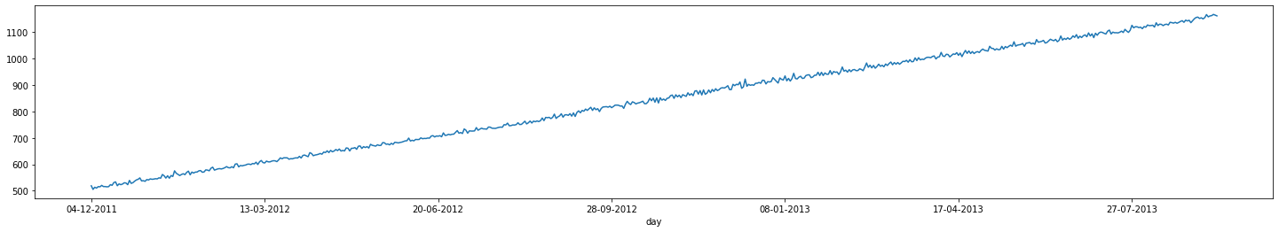
Evaluation of Training data. We have split our dataset into 80-20 as training and testing sets.

Slide 26
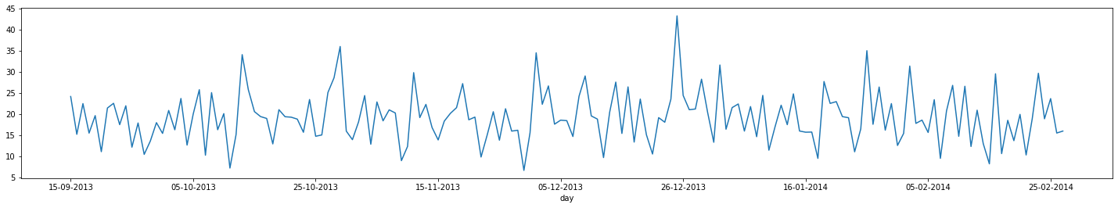
Evaluation of testing data

Slide 27
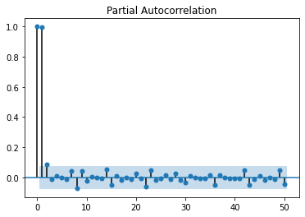
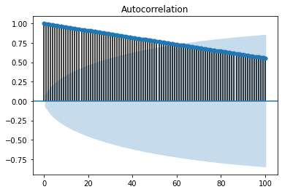
SARIMA MODEL EVALUATION
The publicly available electricity consumption dataset of London from November 2011 to February 2014 is used for this project and split into the training set and the testing set of ratio 80:20. To find the optimal values (p, q) auto correlation function (ACF) and partial autocorrelation function (PACF) is applied.

Slide 28
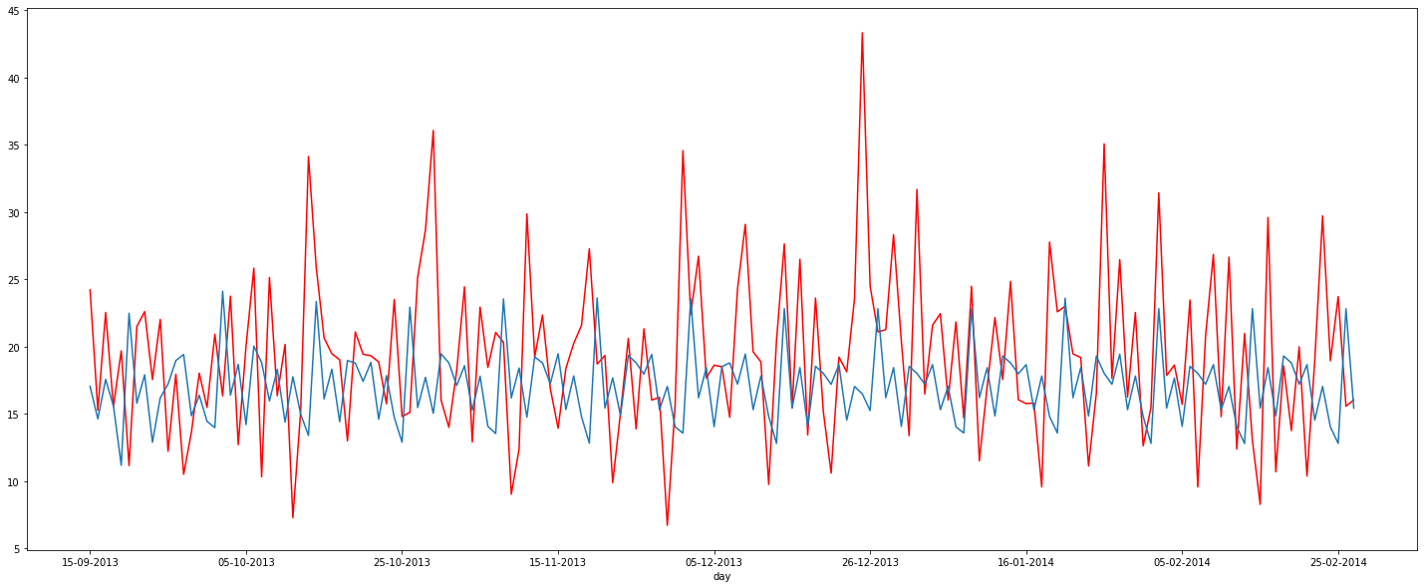
The total consumption and forecasting of electricity data is plotted with total consumption as red colour and the predicted plot as blue colour.

Slide 29
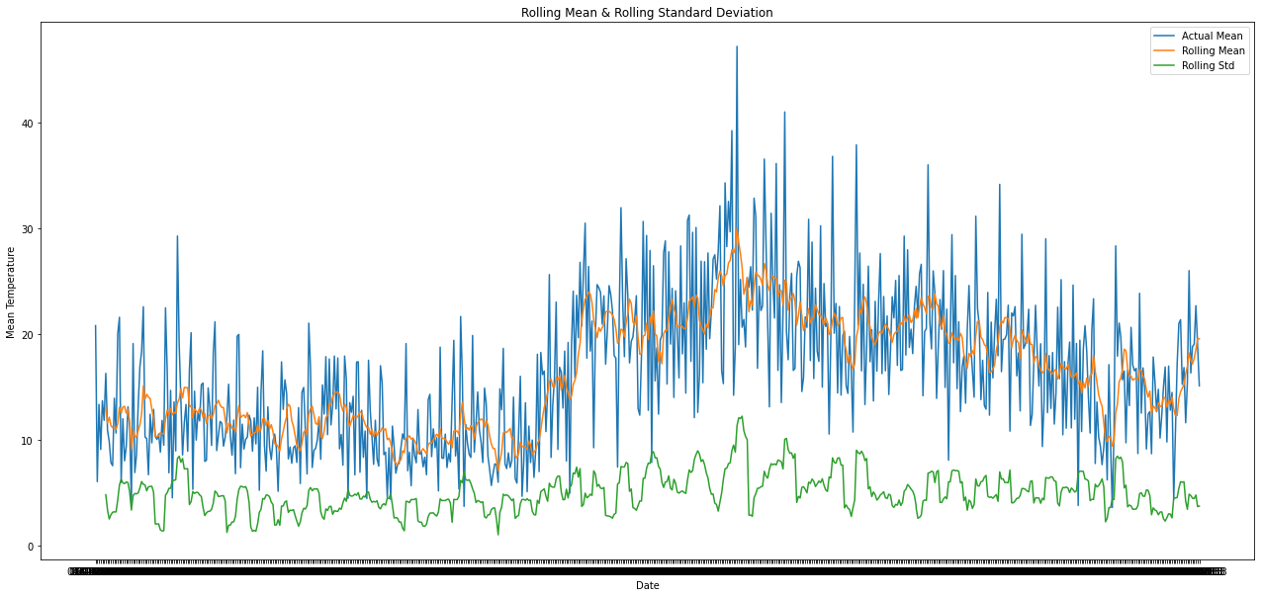
check stationary: mean, variance(std)and adfuller test

Slide 30
SARIMA RESULTS
The Evaluation results of SARIMA are as follows: Mean Absolute Error =4.72135437279449 Mean Absolute Percentage Error = 28.831713016761846 Mean Square Error = 48.51340072760808 Root Mean Square Error = 6.965156188313948

Slide 31
Multi-Layer Perceptron (MLP):
A multilayer perceptron (MLP) is a type of artificial neural network (ANN) for feedforward. In general, ANN is a model of operation consisting of a large number of interconnected nodes (neurons).
Each node contains a specific output function called function activation. The connection between each of the two nodes is a weighted value that passes through the signal of the connection called weight.
The weight of each node in ANN is having memory. MLP has several layers, the first layer is the layer of input, the last layer is the layer of output, the middle layers are called hidden layers and each layer contains many neurons.

Slide 32
Implementation of MLP:
After pre-processing the electricity consumption data, In MLP process the time parameter is dropped and the frequency is kept constant. The training and testing data are reshaped into input (x = t) and output (y = t+1).
The data of each block has been split into 80:20 ratio i.e., 80% as training data and 20% as testing data.
The number of times entire training data batch to be iterated is defined as epoch and it is set to be 100 in this case

Slide 33
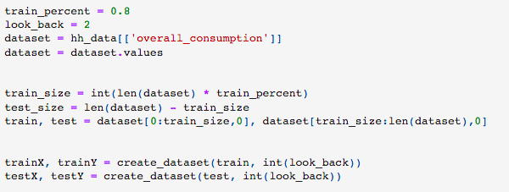

Slide 34
RELU FUNCTION:
In designing the best deep neural networks, RELU function is used. For the negative values of output, the gradient will be zero and represented as A(x) = max(0,x). This allow the gradient to be non-zero and training will be recovered gradually.
OPTIMIZER:
Inorder to train the neural networks quickly and more efficiently then the best optimizer to choose is Adaptive Moment Estimation (ADAM).

Slide 35
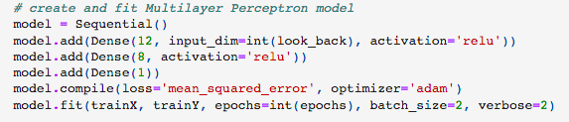
The three-layer multilayer perceptron model with the activation function RELU and ADAM optimizer is defined to create and fit the model in load forecasting data. The loss function chosen is mean squared error.

Slide 36

Evaluation of MLP model and results:
MLP model is used to predict the demand of electricity forecasting with the help of statistical errors. The 80:20 ratio of train-test data is processed to get the results. The error results obtained from the MLP model over time are as follows:

Slide 37
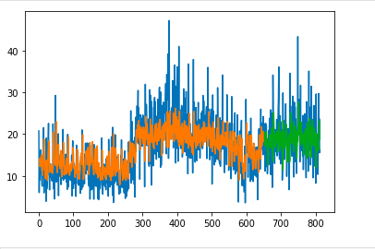
The Evaluation results of MLP are as follows: Mean Absolute Error = 3.7596725048339845 Mean Absolute Percentage Error = 29.76129646693374 Mean Square Error = 45.651844579981365 Root Mean Square Error = 6.756614875807364
Graphical representation of historic and predicted data:

Slide 38
References:
https://www.wisdomgeek.com/development/machine-learning/sarima-forecast-seasonal-data-using-python/
https://machinelearningmastery.com/sarima-for-time-series-forecasting-in-python/
Ringwood, J., Bofelli, D. and Murray, F., 2001. Journal of Intelligent and Robotic Systems, 31(1/3), pp.129-147
. Chen, Peng & Niu, Aichen & Liu, Duanyang & Jiang, Wei & Ma, Bin. (2018). Time Series Forecasting of Temperatures using SARIMA: An Example from Nanjing. IOP Conference Series: Materials Science and Engineering. 394. 052024. 10.1088/1757- 899X/394/5/052024.

